Slide 1
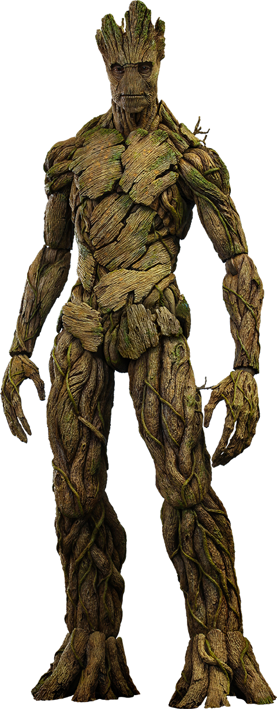
Epidermodysplasia Verruciformis (Tree Man Disease)
Jack, Both Bens, and Angus

Slide 2
Problem
Epidermodysplasia
-An incurable disease that is the result of uncontrolled HPV infection
-Immune system suppressed along with absence of EVER1 and EVER2 two vital cell proteins
-Iconic symptom is the presence of large warts that mostly grow on hands and feet

Slide 3
HPV
HPV is a disease that disrupts the body’s ability to produce proteins EVER1 and EVER2.
These proteins transport Zinc into the cell
The reason the body can not produce these proteins is due to the fact that HPV mutates or silences genes TMC-6 and TMC-8, the sole producers of EVER1 and EVER2.

Slide 4
Zinc
A patient with Epidermodysplasia Verruciformis has a deficiency in the gene that produces proteins EVER1 and EVER2
These are proteins that bind to Zinc in order to transport it across the cell membrane
Zinc is used to help the immune system fight off invaders
Zinc is also used to help make other proteins and replicate DNA

Slide 5
Biotech Product
Our Biotech product is to use the patient's bone marrow cells to produce more EVER1 and EVER2. By isolating EVER1 and EVER2’s topogenic sequence, or the exact 25 amino acid combination, we can instruct cells in a cell culture to only obey the instructions of those 25 amino acids.
However, simply injecting the patient with EVER1 and EVER2 will not fix the problem. So several surgeries will be needed to remedy them completely of the disease.

Slide 6
Biotech Product Test
To see if the situation improves, we will inject an HPV infected mouse with EVER1 and EVER2 proteins and record the results
If proven successful in improving the mouse’s condition, we will move ahead and test the surgery on the mouse
Surgery explained on next page
Unfortunately, there are no other reliable ways of testing our solution

Slide 7
The Surgery
The perfect end result would to be to have the patient totally cured of E.V.
How to cure them of this will be an extreme form of gene therapy known as a Conditional Knockout
How this works will be to inject the patient with a an enzyme known as Cre-Lox
Cre-Lox, if used correctly, targets mutated or inactive genes, and represses their ability to produce the protein
Next an injection of a viral enzyme that works with the Cre-Lox; that enzyme is called Cre-Recombinase

Slide 8
Post Operation
Once the gene has been “eliminated” the patient will be in need of a large supply of EVER1 and EVER2
Using the EVER1 and EVER2 already produced by the patient's own cells they will receive multiple injections of EVER1 and EVER2 until a full blood transfusion takes place

Slide 9
Why It Will Work
With the immune system suppressed, simply leaving the patient alone after the surgery will not work
The blood is still infected with the ability to spread and infect more and more cells
That is why a blood transfusion basically replacing the patient's blood will be needed
This blood will have the two fully functional genes TMC-6 and TMC-8 so that injections of Zinc will not be needed because the body will produce it itself

Slide 10
Credentials
After emailing three virtual mentors, none of them got back to us but here are their credentials
Nicole Aagaard- Biotechnician for the University of Utah
William Curtis Connor- Biotechnician and Chemical Engineer professor for the university of Massachusetts
George Carrol- A biologist at the University of Oregon who studies viruses and cells

Slide 11
Citations
Citations:
Kao, Grace F. “Epidermodysplasia Verruciformis” August 11, 2014
http://emedicine.medscape.com/article/1131981-overview
Geneoway.com “Custom Knockout Mouse Models”
https://www.genoway.com/services/customized-mouse/knockout-models/conditional-ko-tissue.htm
Ingenious Laboratory “Conditional Knockout Mouse Models”
http://www.genetargeting.com/products-and-services/types-of-mouse-models/conditional-knockout-mouse-models/
Molecular Biology 4th edition “Insertion of Membrane Proteins into the ER Membrane”
http://www.ncbi.nlm.nih.gov/books/NBK21731/
CDC Human Papillomavirus (HPV) “Genital HPV Infection Fact Sheet”
http://www.cdc.gov/std/hpv/stdfact-hpv.htm

Slide 12
THE END

